Slide 1

Goal Setting and
Action Planning

Slide 2
Goal Setting
The most important thing about goal setting, is to have one!
Goals are like road maps; they get you from one point to another.
Goals provide the direction you need to reach your destination, the motivation to sustain you on your trip, and a way to measure your progress.
The best way to get results is to plan for the future, but live one day at a time.

Slide 3
How to set goals?
Identify your personal values and mission statement.
Figure out the goals you want to achieve.
Write your goals down (5-6 at a time is Ok). Make sure the goals are SMART and they are top quality goals.
List the skills and knowledge required to reach your goal.
Develop a personal action plan.
Review your progress and update your goals accordingly.
Celebrate your success
Start the process all over again.

Slide 4
Goals must be “SMART”
S- Specific :- Well defined target – Needs to help provide direction, purpose..
M- Measurable:- If you can not measure it, you can not achieve it. Measure in absolute terms (Kg, hrs, nos. …..)
A- Actionable :- Goal should be actionable – Develop a Strategy
R- Realistic:- need to be challenging & stretching but not unrealistic that they are unachievable – Also relevant.
T- Time bound :- Starting date and finishing date should be fixed by you.

Slide 5



SPECIFIC
What details do you want to accomplish?
“I want to do better in studies”
“I want to increase my study grade from a C+ to an A.

Slide 6



MEASURABLE
All goals should have a way to evaluate whether or not they were accomplished.
“I want to run the mile better.”
“I want to improve my mile time by 30 seconds.”

Slide 7



ATTAINABLE
Goals must be something you are capable of reaching.
Which one would be a better goal for an injured cricketer?
“I will help my team to win the match”
“I will rehabilitate my knee so that I can play cricket again next season.”

Slide 8



RELEVANT
Make goals that are important to you and your lifestyle.
Which goal is better for a teacher?
“My goal is to discover a cure for cancer”
“My goal is to inspire at least one student to become a doctor to research a cure for cancer”

Slide 9


TIME - BOUND
Make sure that you have a time set as a “dead line” so your goal is not unending.
“My goal is to be able to run a half marathon.”
My goal is to run in a half marathon by the end of this year.

Slide 10
Overarching
Goals
(Aspirations)
Effort
Response to Supervision
Scripts
Follower Behavior
Self-Messages
Corporate Lore
Personal Practices
Superordinate
Goals
(Motives)
Personal
Practices
Performance
How Aspirations Become Translated into Performance

Slide 11
How does Goal setting work?
Goals direct attention
Goals Regulate Effort
Goals increase persistence
Goals foster the development and application of Task Strategies & Action Plans

Slide 12
Goal Setting Theory
Dr. Locke and Dr. Gary Latham published their fundamental work, “A Theory of Goal Setting and Task Performance“, in which they have outlined five principles of goal setting, based on almost 400 studies about goals and organizational performance.
  Clarity
  Challenge
  Commitment
  Feedback
  Task complexity

Slide 13
Important Features of Goal Setting
The willingness to work towards attainment of goal is main source of job motivation.
Clear, particular and difficult goals are greater motivating factors than easy, general and vague goals. Very difficult and complex goals stimulate riskier behaviour.
Specific and clear goals lead to greater output and better performance. Goals should be realistic and challenging. This gives an individual a feeling of pride and triumph when he attains them, and sets him up for attainment of next goal. The more challenging the goal, the greater is the reward generally and the more is the passion for achieving it.
Better and appropriate feedback of results directs the employee behavior and contributes to higher performance than absence of feedback. Feedback is a means of gaining reputation, making clarifications and regulating goal difficulties. It helps employees to work with more involvement and leads to greater job satisfaction.
Participative goals, assigned goals and self set goals are equally effective. It has been researched and identified that no single approach can be adopted and that method is the best that is suited to the individual and situation in hand.

Slide 14
Eventualities of Goal Setting
Self-efficiency- Self-efficiency is the individual’s self-confidence and faith that he has potential of performing the task. Higher the level of self-efficiency, greater will be the efforts put in by the individual when they face challenging tasks. While, lower the level of self-efficiency, less will be the efforts put in by the individual or he might even quit while meeting challenges.
Goal commitment- Goal setting theory assumes that the individual is committed to the goal and will not leave the goal. The goal commitment is dependent on the following factors:
  Goals are made open, known and broadcasted.
  Goals should be set-self by individual rather than designated.
Correlates with the Organizational Vision-Individual’s set goals should be consistent with the organizational goals and vision.

Slide 15
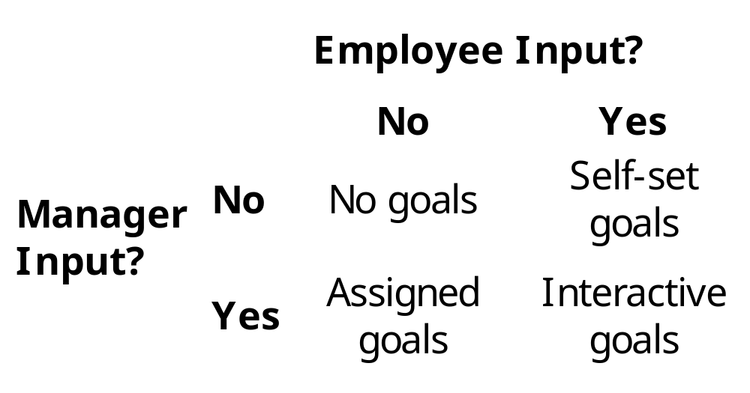
Employee and Managerial Input in Goal Setting

Slide 16
Advantages of Goal Setting
Goal setting is a technique used to raise incentives for employees to complete work quickly and effectively.
Goal setting leads to better performance by increasing motivation and efforts, but also through increasing and improving the feedback quality

Slide 17
Limitations of Goal Setting
At times, the organizational goals are in conflict with the managerial goals. Goal conflict has a detrimental effect on the performance
If the employee lacks skills and competencies to perform actions essential for goal, then the goal-setting can fail and lead to undermining of performance.
There is no evidence to prove that goal-setting improves job satisfaction.

Slide 18
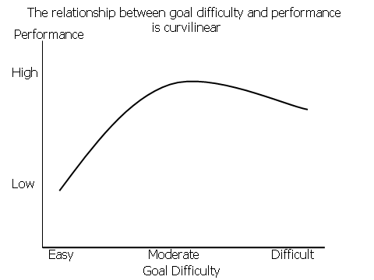
Goal Difficulty & Performance

Slide 19


Final tips to Goal Setting
Write down your goals and look at them often!
If you achieved your goals too easily, make your next goals harder.
Failure to meet goals only matters if you don’t learn something from your mistakes.
State each goal as a positive statement
Set priorities
Goal setting is an important method of:
  Deciding what’s important for you to achieve.
  Motivating yourself.
  Building self-confidence.

Slide 20
Aids to Successful Goal Setting
Brainstorm - List everything you would like to accomplish.
Prioritize - Look at your list: decide which goal you would like to work with first. Keep your list of goals so that you can check on your progress.
Describe in Detail - Be very specific: break your goals into objectives, a step-by-step plan so you can check on your progress.
Identify Your Barriers - Look for internal and external blocks to reaching your goals.
Develop a Game Plan - Decide ways to overcome the barriers to your goals.
Develop a Timeline - Look at your goals and work out a realistic timeline.
Reward Yourself - Reward yourself for each step you accomplish towards your goals.

Slide 21
Why we don’t set Goals ?
1) A pessimistic attitude.
2) Fear of failure.
3) Lack of ambition.
4) Fear of rejection.
5) Procrastination.
6) Low self-esteem.
7) Ignorance of the importance of Goals

Slide 22
Goal Setting Example

Slide 23
Goal Setting Example
Shivani has decided to think about what she really wants to do with her life. She has worked out on her lifetime goals as follows:
Career – "To be managing editor of the magazine that she works for."
Artistic – "To keep working on her illustration skills. Ultimately she wants to have her own show in the downtown gallery."
Physical – "To go for a mountain trek.“
Now that Shivani has listed her lifetime goals, she then breaks down her career goal into smaller, more manageable goals.
Five-year goal: "Become deputy editor."
One-year goal: "Volunteer for projects that the current Managing Editor is heading up."
Six-month goal: "Go back to school and finish the journalism degree."
One-month goal: "Talk to the current managing editor to determine what skills are needed to do the job."
One-week goal: "Book a meeting with the Managing Editor."

Slide 24
Benefits of Goal Setting
Goal is like GPS in life. It gives a direction and helps one choose where to go in life. It allows one to envision an ideal future and to turn it into reality, hence giving control over one’s life.
Goals help to focus on what is important
Goals help identify and establish the priorities and make the right choices and good decisions based on a long-term perspective
Goals allow one to focus and concentrate their time and energy on the task, Keeping away all the distractions and thus finishing the task efficiently
Working at , measuring and achieving goals allows one to become self-confident and enthusiastic
Goals are the starting point of success. A good start is what it takes to get closer to success

Slide 25


